Slide 1

Bugle
Making a Difference Just Got Easier!
Team: Sachin Kumar, Sumit Srivastava, Pooja Gosavi, Nida Syed, Lin Zhu, Shyam Ramakrishnan, Cameron Harris

Slide 2


What is Bugle?
Notes:
[Sachin] Problem : Bugle is a volunteering app that help bridge the Disconnect between volunteers and organisations
Solution: Bugle app as platform for
Volunteers interested in participating in volunteering events suiting their interests
Organisations in search of the enthusiastic volunteers who share their passion

Slide 3
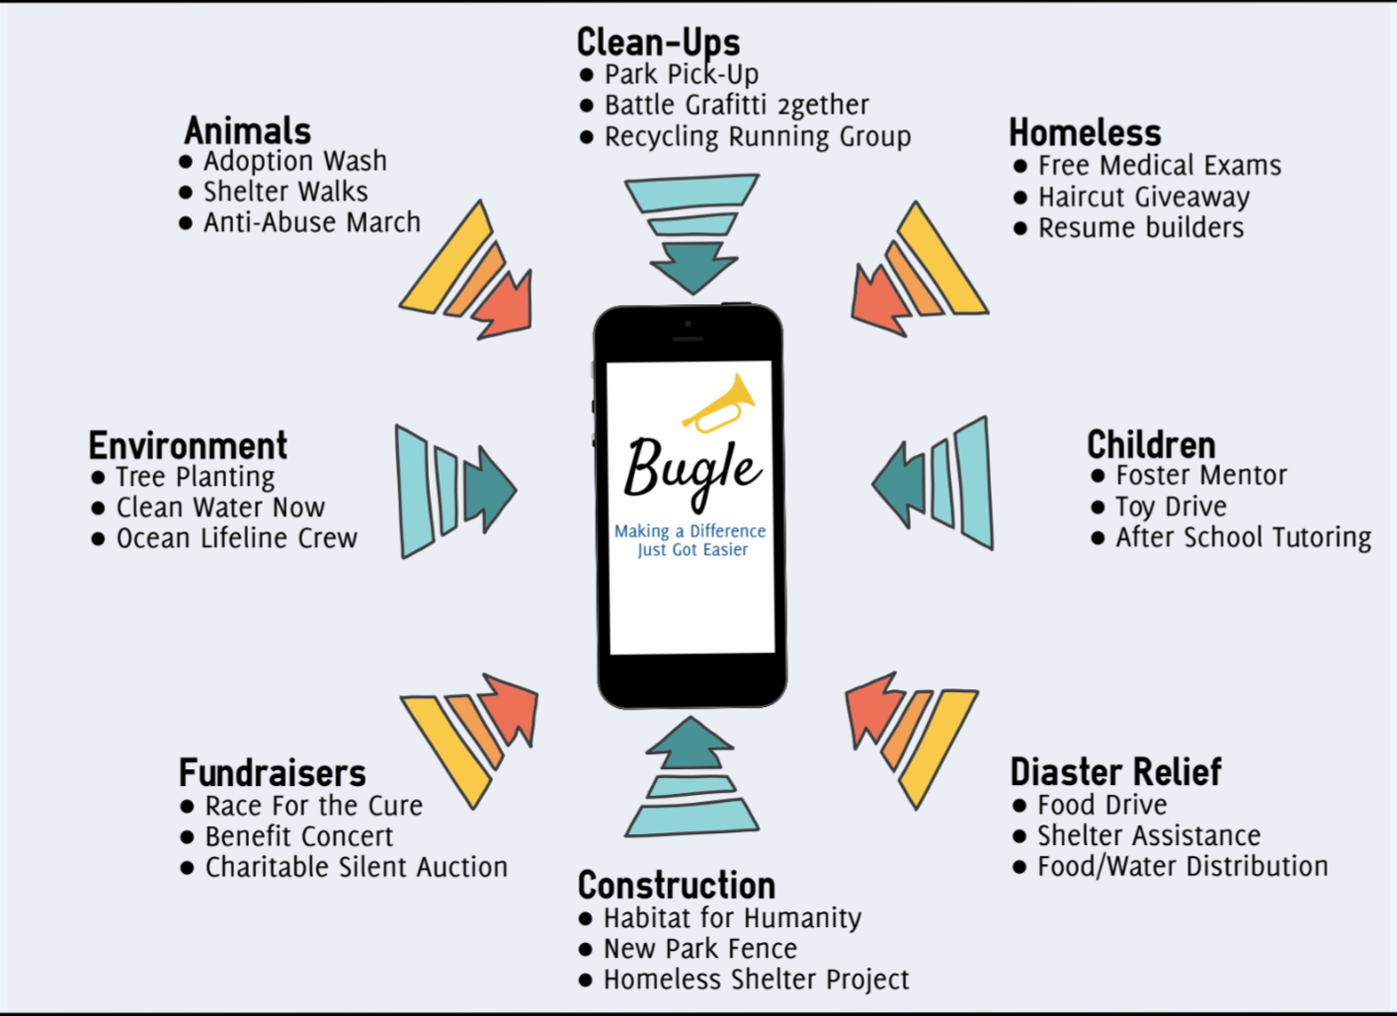
Notes:
[Nida]
Where can Bugle be used?
Various org can be viewed
User can see upcoming events for an org
Based on personal preference, the user can choose an event to volunteer at
Connects volunteers and organizations seamlessly

Slide 4






Technology Stack
Notes:
[Cameron]
We are building a mobile website, and we plan on using some of these technologies.
Mongodb for database, nodejs for backend, socket.io for implementing the chat, AngularJs for front end and we might use React Native, later if we need to convert it into an app.

Slide 5
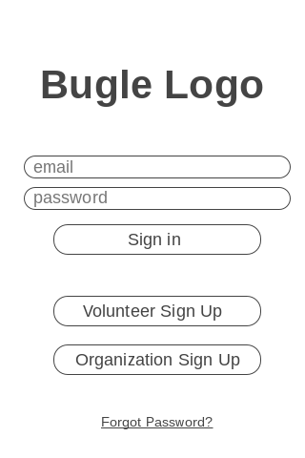
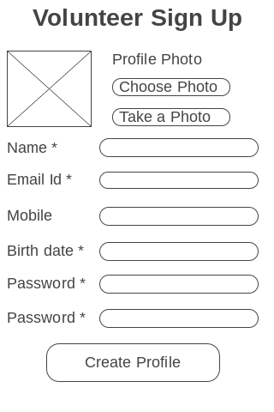
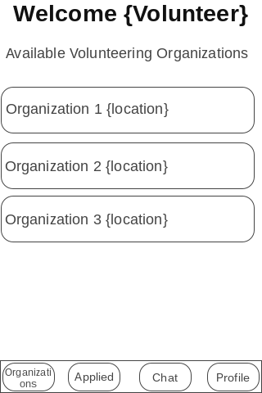
Wireframe Design: Volunteer
Notes:
[Sumit]
We have some basic wireframe design of the app.
2 types of sign up - volunteer and organization
Volunteers Sign Up page.
The events are classified based on organizations. And volunteers can view the events for each org.

Slide 6
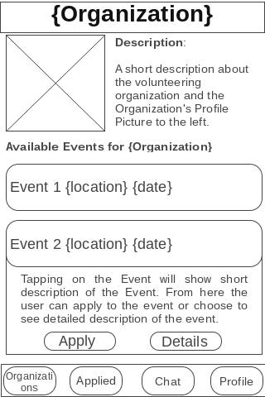
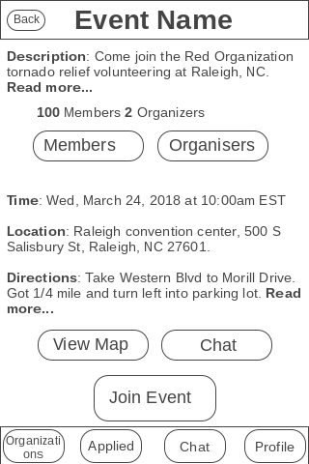
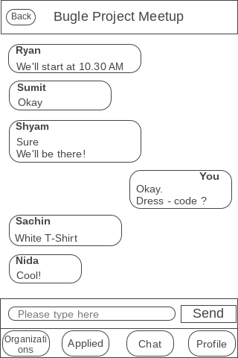
Wireframe Design: Details
Notes:
[Pooja]
Org details page - how a volunteer will view an organization - Volunteer look at the event list of a particular org - quick apply feature with short event description.
Second - event details. Click on an event - view event details - join/apply for an event.
Chat - once approved, all volunteers and orgs will have a chat-room for discussion. No need to phone number since it is integrated with the app!

Slide 7
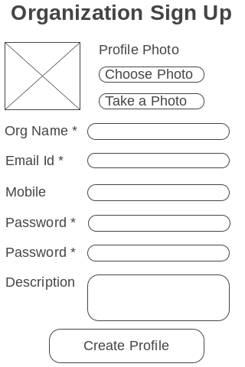
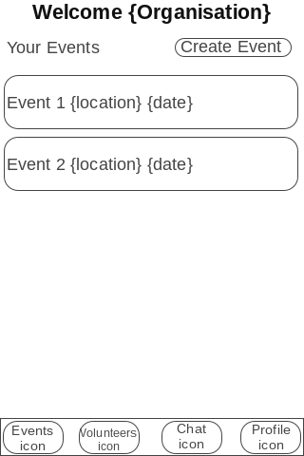
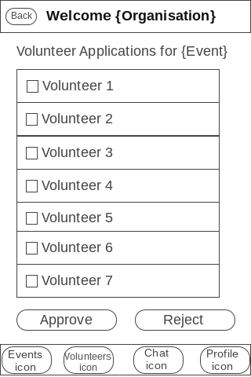
Wireframe Design: Organization
Notes:
[Shyam]
We have pre-configured orgs - Red, White & Blue. But new orgs can sign up on the app.
Orgs can view their list of events, create and manage events from their Events page.
For a given specific event, orgs can view list of volunteer applications. They can either approve, reject or waitlist applications.

Slide 8



Related Work (#VolunteerFight!)
vs
Notes:
[Lin]
Mention how we are different from these apps.
For both volunteers and organizations
Chats
Background Verification.

